Slide 1
Raspberry Pi
Workshop 2 by Robotics Club
By : Eng. Abdallah Amr / Ahmed Mohammed / Ahmed Yasser

Slide 2
What is a raspberry pi?
Single Board Computer
Small size
Open source
Learning platform

Slide 3
Comparison
PC
Raspberry Pi
Arduino

Slide 4
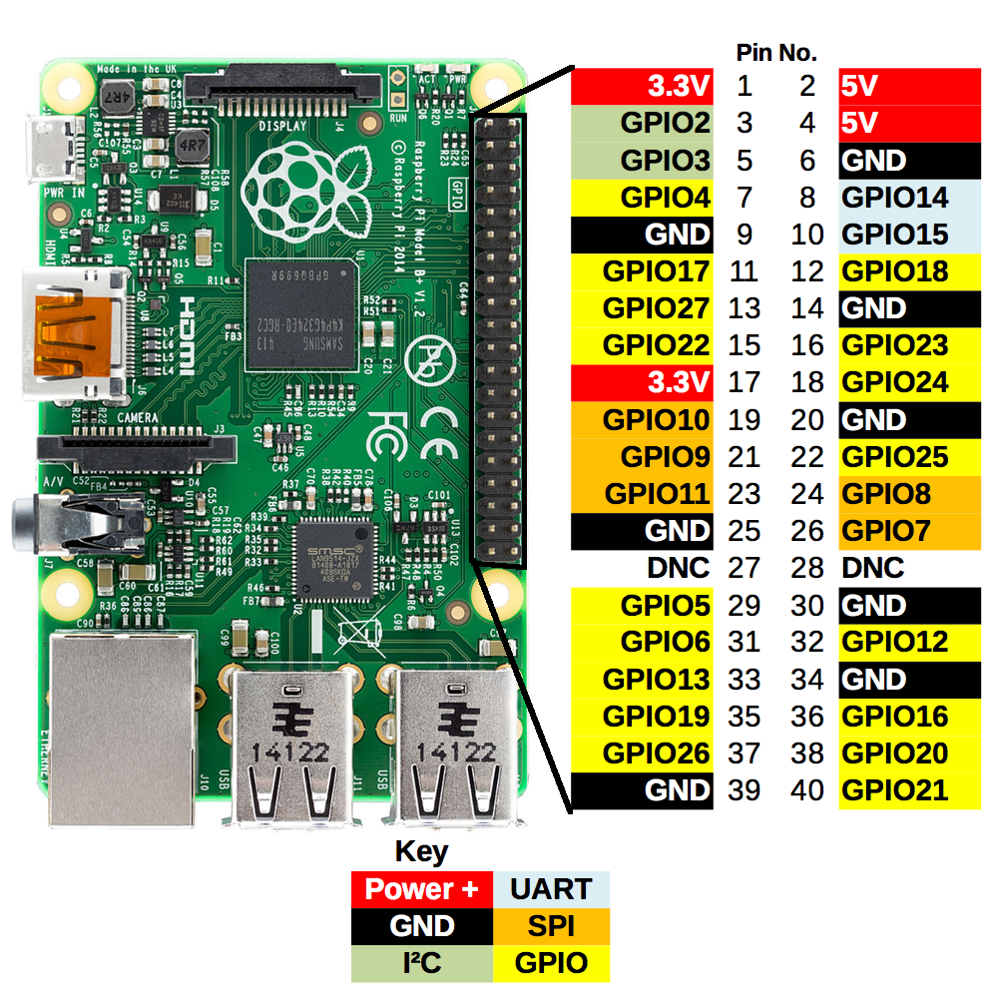

Slide 5
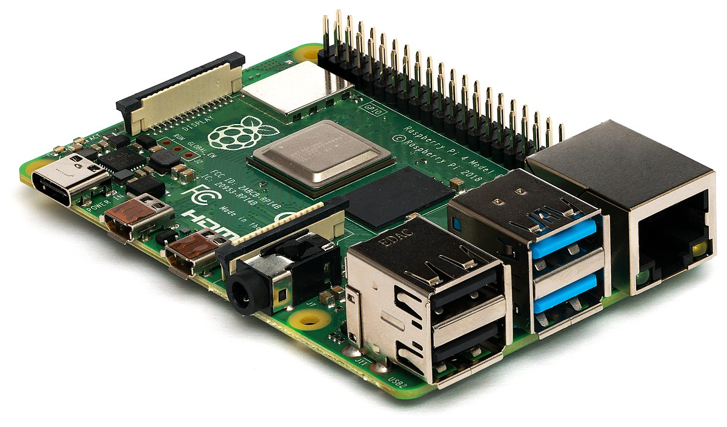
Components

Slide 6
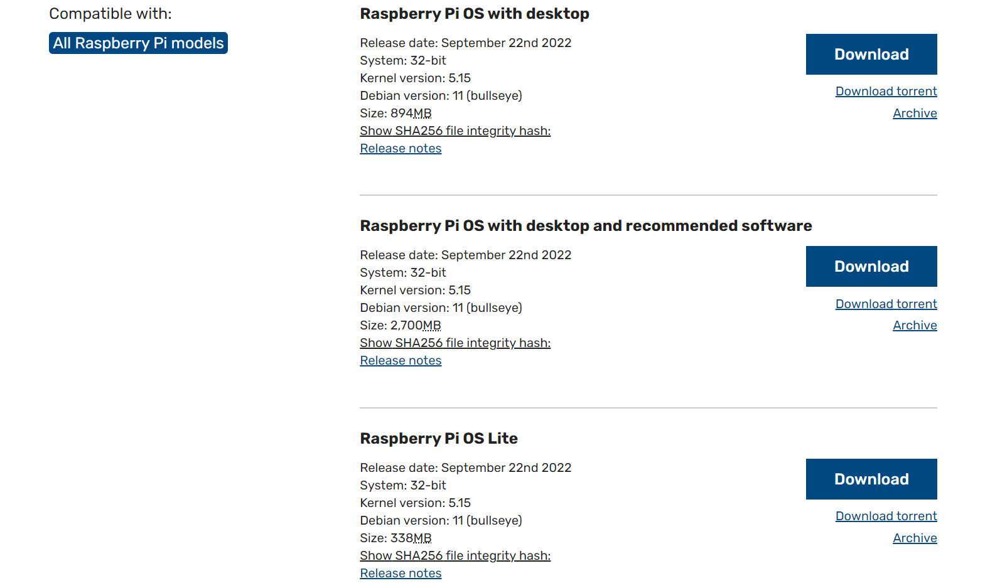
Operating System

Slide 7
What is Linux?
Operating System open source
Have many based systems (ubuntu, Debian, Raspberry Pi OS)

